Slide 1

CMR INSTITUTE OF TECHNOLOGY:HYDERABAD Department of Computer Science and Engineering
CLASS:III- B.Tech V- SEMESTER
Regulation:R22
Course Code | Subject | POs | PSOs
22CSPC54 | Information and Cyber Security | 2,3,6,8,12 | 1
Course Outcomes (COs) & CO-PO Mapping (3-Strong; 2-Medium; 1-Weak Correlation)
COs | Upon completion of course the students will be able to | PO2 | PO3 | PO6 |  | PO8 |  | PO12 |  | PSO1
CO1 | Explain information and cyber security terminologies | 2 | 2 |  | 2 |  | 3 |  | 2 |  | 3
CO2 | Apply cryptography for security networks | 3 | 3 |  | 3 |  | 3 |  | 3 |  | 3
CO3 | Identify various cyber offences | 3 | 3 |  | 3 |  | 3 |  | 3 |  | 3
CO4 | Use standards and cyber laws to enhance cyber security | 3 | 3 |  | 3 |  | 3 |  | 3 |  | 3
C05 | IIlustrate the importance of security policies & IT Act | 3 | 3 |  | 3 |  | 3 |  | 3 |  | 3

Slide 2
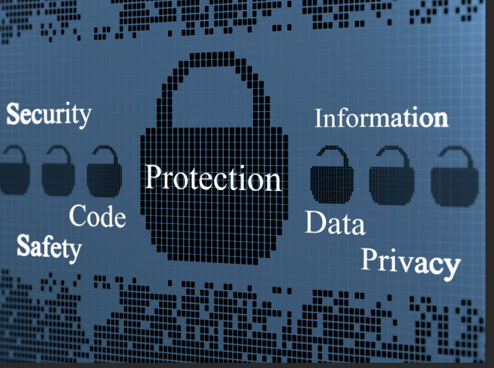
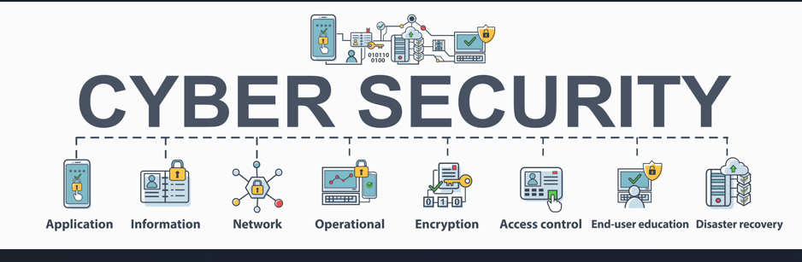
INFORMATION AND CYBER SECURITY

Slide 3
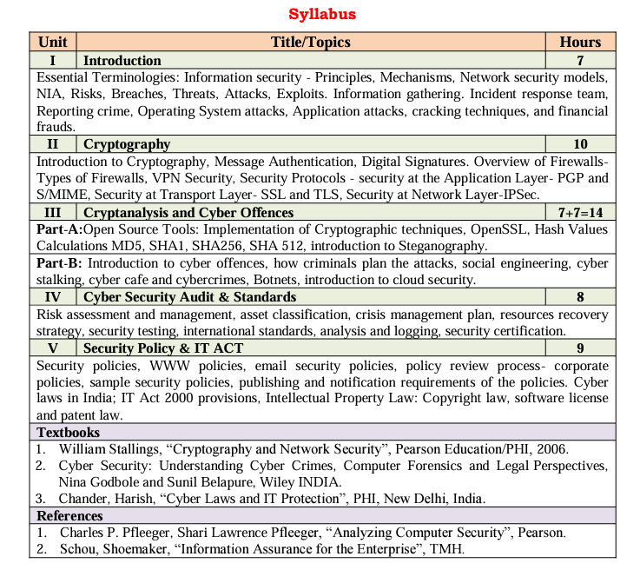

Slide 4
UNIT 1 TOPICS
Basic terms and Mechanisms
CIA triad
Network Security Models
NIA
Risks
Breaches
Threats
Attacks
Essential Terminologies
Exploits
Information Gathering
Incident response team
Reporting Crime
Operating System Attacks
Applications attacks
Reverse Engineering
Cracking Techniques
Financial Frauds

Slide 5
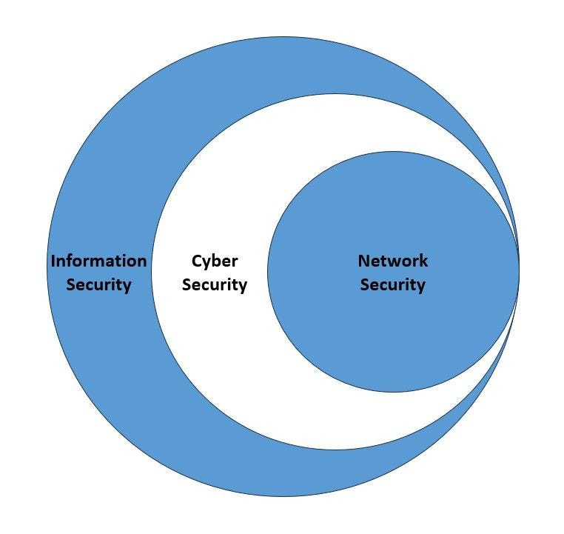
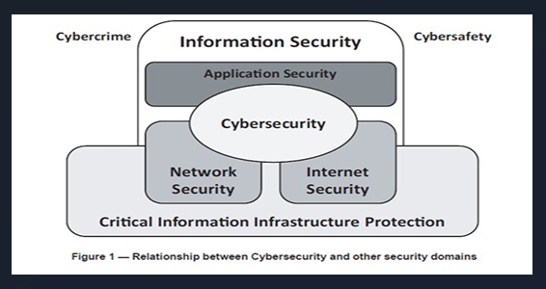
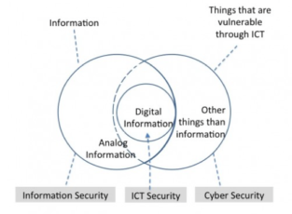
Understanding of Information security and Cyber Security
Fig: Cyber Security is Subset of Information security
Fig:Information security and cyber security

Slide 6
ESSENTIAL TERMINOLOGIES
Computer Security-generic name for the collection of tools designed to protect data and to thwart hackers
Network Security-measures to protect data during their transmission. This area covers the use of cryptographic algorithms in network protocols and network applications.
Terms Information security and Cyber security are often used interchangeable.
Cyber Security: It is the practice of protecting the data from outside the resource on the internet.
Information Security: It is all about protecting information from unauthorized users, access, and data modification or removal in order to provide confidentiality, integrity, and availability.

Slide 7
Types of security
Network Security
Cyber Security
Cloud Security
Computer Security
Computer network Security
CrypoGraphy Security
Wireless sensors Security

Slide 8
Minimization the risk
It is essential to be alert for the safety on the internet. Thus, there are actions that can minimize the risk:
1. Protect Your Passwords:
Change your passwords regularly (every three months, at least);
12-character passwords are more secure than passwords with 8 as well as passwords with letters and numbers;
Do not use words related to personal information (eg. name, date of birth, login, mother’s name, etc.);
It is unwise to write passwords on paper;
Avoid using the option of your browser (Internet Explorer, Mozilla, Chrome) for password management, because those who use the computer, can utilize them.
2. How To Receive e-Mails With Links And Attachments:
When receiving emails with deals, avoid clicking on links.
Open another instance of the browser, enter the address of the seller and look for the offer.
The link may have an address, but direct it to another, who will run a malicious program (spyware, trojans, etc.). The safest answer is not open files and do not click on links sent by email.

Slide 9
On Public Computers (eg. Cyber Cafe.):
Extreme Caution. There are no guarantees about the programs installed and there may be programs to store passwords, installed by previous users. If there is no other option for internet access, close all programs after use, log-off and clear the history in the browser (Tools / Options / Clear History).
3. Physical Protection Of The Computer Is An Essential Practice:
Absenteeism briefly the table can be enough for someone else to install a program that captures passwords and personal information. Lock system access, password, when not using the computer.
4. By “Plugging” The Computer Networking:
Using your personal computer in the network (ie wireless.), some basic precautions are:
Use the option of encrypted data for traffic information. Verify that the network has WPA (Wi-Fi Protected Access) or WEP (Wired Equivalent Privacy) function, the first being safer;
Disable folder sharing (Windows), or secure access to the operating system with a password.
Other users within the same network (including wireless) may be able to seek and write files on your computer;

Slide 10
5.Care To Share Files:
File sharing programs connect your computer to millions of others to exchange music, video and other types of information. This is done through programs installed that may compromise the security of your computer. If you decide to use these programs, be careful: adjust the setting to folders that must be shared or not; and read the contract (“end user licensing agreement”) to be aware of potential risks.
6. Antivirus, Antispyware And Firewall:
Its use is recommended, as well as regular updating of lists (blacklists, virus definitions). The web browsers offers a “fraud” option whose settings can avoid sites which send unsolicited emails (spam) and websites that spread viruses and spyware to steal sensitive data from your computer or are involved in fraudulent actions (phishing).

Slide 11
The following are the reasons why information security and cyber security is important:
1. To Protect Personal Information
To prevent yourself from cyber threats, make sure that you protect your personal information and data.
To keep information and data safe and you can do that by implementing the below-mentioned steps:
Implement an anti-virus software.
Update the operating system of your computer regularly.
Apply smart password and other locks.
Always take a backup of your critical data information.
Use computer locks for safety.
Do not fall for the traps of phishing emails.

Slide 12
2. To Protect Company/institutional Properties
A company involves a lot of sensitive information and assets. (It is very important to protect the organization's important information and sensitive data so that it can prevent itself from any unauthorized access or misuse)

Slide 13
3. To Prevent Data Theft
Data help means stealing any critical and sensitive information such as account passwords, bank account details, health-related information, personal information, important documents that are stored in the computer systems and its servers, and so on.
Data theft can happen for multiple reasons that can be stated as follows:
Stolen and weak credentials.
Errors caused by humans.
Presence of any malicious insiders.
Some application vulnerabilities.

Slide 14
4. To Prevent Malware and Viruses
Computer viruses and malware can be very annoying at times and computer security can help you to prevent your system from these unwanted visitors.
These simple steps:
Keep your software updated.
Use paid and good professional software for antivirus.
Apply a strong password to your computer system.
Do not click irrelevant links on your system.
Always back up your sensitive computer data.
Only go through trusted and authorized security websites.

Slide 15
5. To Protect From Unauthorized Access
By installing computer security in your system
It prevents hackers from getting access to your computer system and controls your critical information

Slide 16
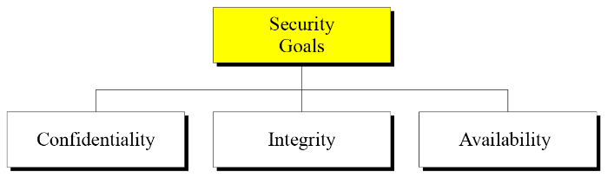
Security Principles (CIA Triad)
There are three security principles.
Confidentiality
Integrity
Availability
Confidentiality
Confidentiality is probably the most
common aspect of information security.
Example: Industrial Confidential data, Bank

Slide 17
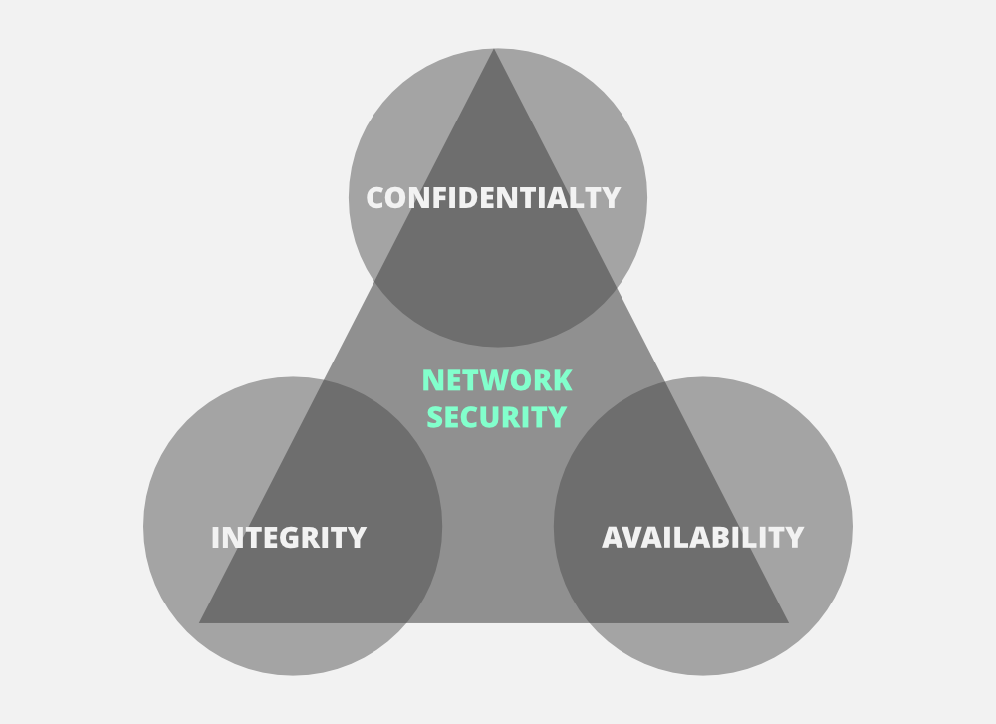
Integrity
Information needs to be changed constantly. Integrity means that changes need to be done only by authorized entities and through authorized mechanisms.
Example: Bank data should be automatically updated after any transaction.
Availability
The information created and stored by an organization needs to be available to authorized entities. Information needs to be constantly changed, which means it must be accessible to authorized entities.
Example: Accessing of information anywhere at any time.
FIG: CIA TRIAD

Slide 18
CIA Triad
The three letters in "CIA triad" stand for Confidentiality, Integrity, and Availability. The CIA triad is a common model that forms the basis for the development of security systems.
Standard measures to establish confidentiality include:
Data encryption - Data encryption is a security method where information is encoded and can only be accessed or decrypted by a user with the correct encryption key. Encrypted data, also known as ciphertext, appears scrambled or unreadable to a person or entity accessing without permission.
Two-factor authentication - Two-factor authentication (2FA) is an identity and access management security method that requires two forms of identification to access resources and data. 2FA gives businesses the ability to monitor and help safeguard their most vulnerable information and networks
Biometric verification - Biometric verification is any means by which a person can be uniquely identified by evaluating one or more distinguishing biological traits. These biological identifiers include fingerprints, hand and earlobe geometries, retina patterns, voice prints and written signatures.
Security tokens-A security token is a digital asset that represents ownership or participation in a real-world asset, such as shares in a company, real estate, or commodities. Examples of security tokens in crypto include Polymath, tZero, Harbor, and Securitize

Slide 19
Integrity
Integrity refers to protecting information from being modified by unauthorized parties.
Standard measures to guarantee integrity include:
Cryptographic checksums-MD5, SHA-1, SHA-256 and SHA-512
Using file permissions
Uninterrupted power supplies
Data backups

Slide 20
We have two common types: SHA (Secure Hash Algorithm) and MD5(Message Direct 5). Now MD5 is a 128-bit hash and SHA is a 160-bit hash if we’re using SHA-1. There are also other SHA methods that we could use like SHA-0, SHA-2, and SHA-3.
Let’s assume Host ‘A’ wants to send data to Host ‘B’ to maintain integrity. A hash function will run over the data and produce an arbitrary hash value H1 which is then attached to the data. When Host ‘B’ receives the packet, it runs the same hash function over the data which gives a hash value of H2. Now, if H1 = H2, this means that the data’s integrity has been maintained and the contents were not modified.

Slide 21
Availability
Availability is making sure that authorized parties are able to access the information when needed.
Standard measures to guarantee availability include:
Backing up data to external drives
Implementing firewalls
Having backup power supplies
Data redundancy

Slide 22
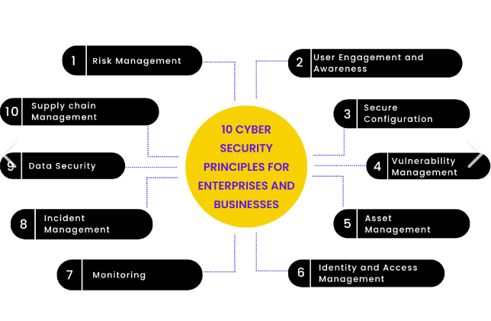
Q. Explain CIA Triad in detail?

Slide 23
Introduction To Classic Security Models
There are 3 main types of Classic Security Models.
Bell-LaPadula
These models are used for maintaining goals of security, i.e. Confidentiality, Integrity, and Availability. In simple words, it deals with CIA Triad maintenance. Biba
Clarke Wilson Security Model
1. Bell-LaPadula
This Model was invented by Scientists David Elliot Bell and Leonard .J. LaPadula.Thus this model is called the Bell-LaPadula Model.
This is used to maintain the Confidentiality of Security. Here, the classification of Subjects(Users) and Objects(Files) are organized in a non-discretionary fashion, with respect to different layers of secrecy.

Slide 24
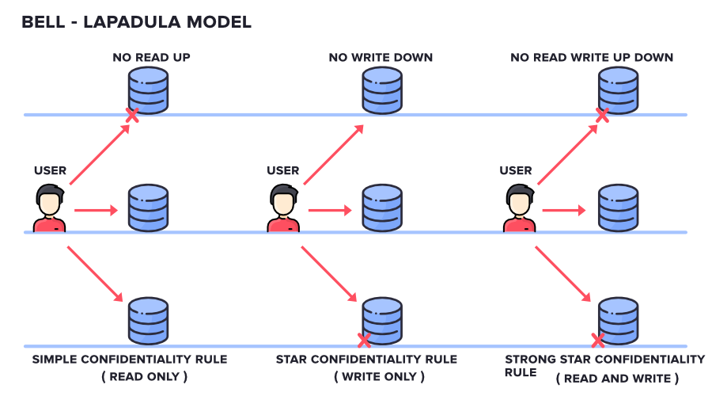

Slide 25
2. Biba
This Model was invented by Scientist Kenneth .J. Biba.
Thus this model is called Biba Model.
This is used to maintain the Integrity of Security.
Here, the classification of Subjects(Users) and Objects(Files) are organized in a non-discretionary fashion, with respect to different layers of secrecy.
This works the exact reverse of the Bell-LaPadula Model.

Slide 26
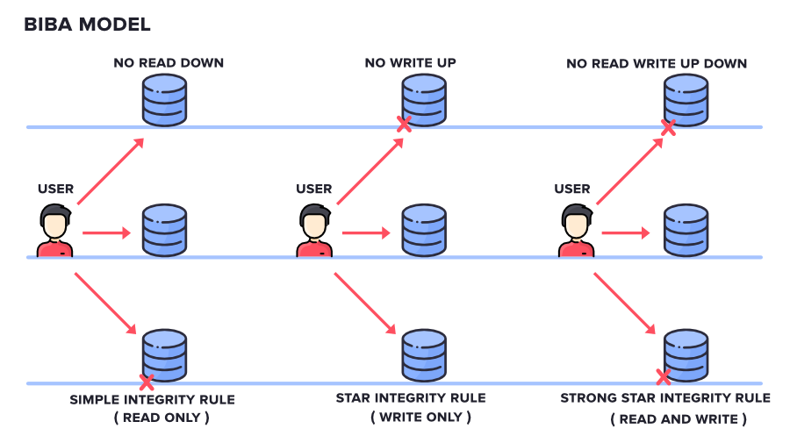

Slide 27
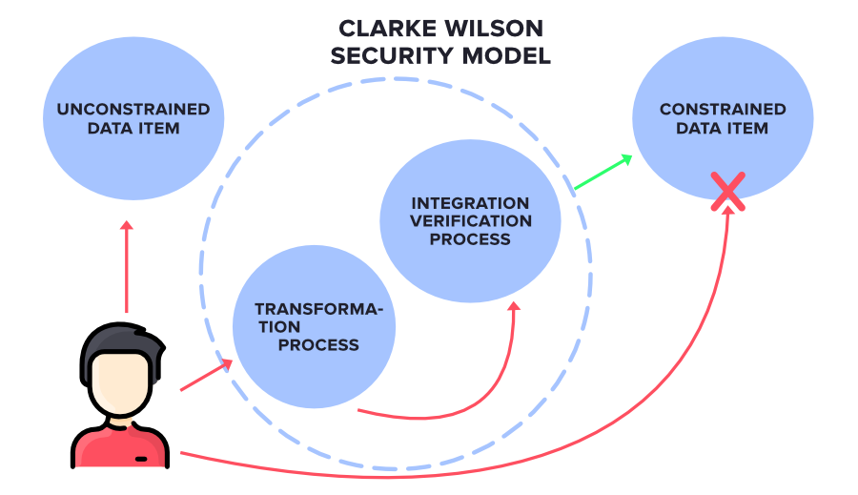
3. Clarke Wilson Security Model
This Model is a highly secured model. It has the following entities.

Slide 28
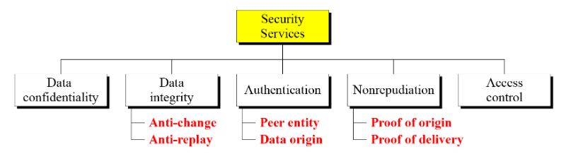
SECURITY SERVICES
ITU-T (International Telecommunication Union – Telecommunication standards)provides some security services and some mechanisms to implement those services.
Security services and mechanisms are closely related because a mechanism or combination of mechanisms are used to provide a service.

Slide 29
Confidentiality: information is not made available to unauthorized individual
Integrity: assurance that the message is unaltered
Authentication: assures recipient that the message is from the source that it claims to be from.
Peer entity authentication: Provides for the corroboration of the identity of a peer entity in an association. Two entities are considered peers if they implement to same protocol in different systems; e.g., two TCP modules in two communicating systems.
Data origin authentication: Provides for the corroboration of the source of a data unit. It does not provide protection against the duplication or modification of data units
Non-Repudiation: protection against denial of sending or receiving in the communication
Access Control: controls who can have access to resource under what condition
Availability: available to authorized entities for 24/7.

Slide 30
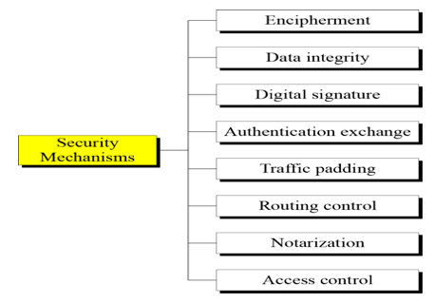
SECURITY MECHANISMS
The security mechanisms defined in X.800. As can be seen the mechanisms are divided into those that are implemented in a specific protocol layer and those that are not specific to any particular protocol layer or security service.

Slide 31
Encipherment
The use of mathematical algorithms to transform data into a form that is not readily intelligible. The transformation and subsequent recovery of the data depend on an algorithm and zero or more encryption keys.
Data Integrity
A variety of mechanisms used to assure the integrity of a data unit or stream of data units
Authentication Exchange
A mechanism intended to ensure the identity of an entity by means of information exchange.
Digital Signatures
A digital signature or digital signature scheme is a mathematical scheme for demonstrating the authenticity of a digital message or document.

Slide 32
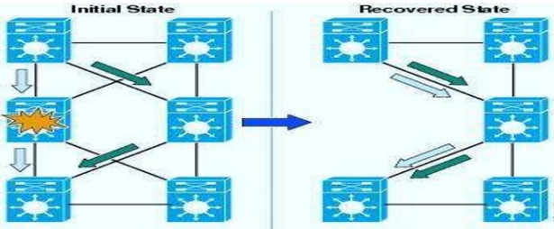
Traffic Padding
The insertion of bits into gaps in a data stream to frustrate traffic analysis attempts.
Routing Control
Enables selection of particular physically secure routes for certain data and allows routing changes, especially when a breach of security is suspected.
Notarization
The use of a trusted third party to assure certain properties of a data exchange.
Access Control
A variety of mechanisms that enforce access rights to resources. Ex: pwd &pins

Slide 33
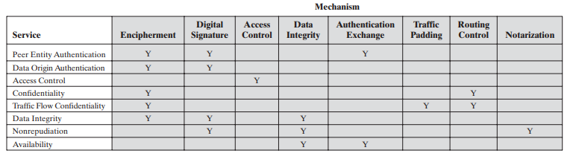
Relationship Between Security Services and Mechanisms

Slide 34
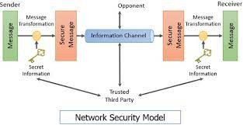
NETWORK SECURITY MODEL
Security aspects come into play when it is necessary or desirable to protect the information transmission from an opponent who may present a threat to confidentiality, authenticity, and so on.
All the techniques for providing security have two components:

Slide 35
A security-related transformation on the information to be sent.
Examples include the encryption of the message, which scrambles the message so that it is unreadable by the opponent, and the addition of a code based on the contents of the message, which can be used to verify the identity of the sender.
Some secret information shared by the two principals and, it is hoped, unknown to the opponent.
An example is an encryption key used in conjunction with the transformation to scramble the message before transmission and unscramble it on reception.
A trusted third party may be needed to achieve secure transmission.
For example, a third party may be responsible for distributing the secret information to the two principals while keeping it from any opponent.

Slide 36
This general model shows that there are four basic tasks in designing a particular security service:
Design an algorithm for performing the security-related transformation. The algorithm should be such that an opponent cannot defeat its purpose.
Generate the secret information to be used with the algorithm.
Develop methods for the distribution and sharing of the secret information.
Specify a protocol to be used by the two principals that makes use of the security algorithm and the secret information to achieve a particular security service.

Slide 37
NIA – NATIONAL INVESTIGATION AGENCY HTTPS://WWW.INDIA.GOV.IN/OFFICIAL-WEBSITE-NATIONAL-INVESTIGATION-AGENCY
National Investigation Agency (NIA) is functioning as the Central Counter Terrorism Law Enforcement Agency in the country.
Information is given about the NIA's mission, objectives, banned organisations, NIA special courts, nodal officers and branch offices etc.
A list of wanted by NIA is also provided. Ex: Al-Qaida
Helpline numbers and contact details of officers are available.
Users can also access the case details under the Agency.

Slide 38
RISKS
The term “information security risk” refers to the damage that attacks against IT systems can cause.
IT risk encompasses a wide range of potential events, including data breaches, regulatory enforcement actions, financial costs, reputational damage, and more.
Although “risk” is often conflated with “threat,” the two are subtly different.
“Risk” is a more conceptual term: something that may or may not happen.
A “threat” is a specific, actual danger.

Slide 39
Risk Assessments
Risk Responses
Identify –Identifying security risk
Analyse -- examine each risk and determine both its likelihood of occurring and the potential impact.
Prevent--to develop controls and procedures to either minimize the damage or prevent it altogether
Document--Clear documentation of your policies and risk mitigation efforts will serve you well long term.
Monitor and Reassess -- monitor the success of your security efforts, reassess your risks periodically (usually once a year), and adjust your policies, procedures, and controls as necessary.
Accept --This response understands that a certain amount of risk is always present. Also known as risk retention, risk acceptance is the decision that the potential gain for a given scenario outweighs the chance of loss.
Share --Another common strategy is to share risk with an outside contractor or partner. An example of risk sharing in IT risk management would be using a cloud storage service like AWS or Microsoft Azure.
Transfer -- Risk transfer is when you move the responsibility for the risk onto an outside party. This is usually done by purchasing insurance for the issue in question.
Avoid--Risk avoidance is generally the safest of these strategies.

Slide 40
BREACHES
A security breach is any incident that results in unauthorized access to computer data, applications, networks or devices. It results in information being accessed without authorization. Typically, it occurs when an intruder is able to bypass security mechanisms.
Technically, there's a distinction between a security breach and a data breach. A security breach is effectively a break-in, whereas a data breach is defined as the cybercriminal getting away with information.
Examples of a security breach
Yahoo --3 billion user accounts were compromised in 2013 after a phishing attempt gave hackers access to the network.
eBay saw a major breach in 2014. Though PayPal users' credit card information was not at risk, many customers' passwords were compromised.
Facebook saw internal software flaws lead to the loss of 29 million users' personal data in 2018.
Marriott Hotels announced a security and data breach affecting up to 500 million customers' records in 2018.

Slide 41
Types of security breaches
There are a number of types of security breaches depending on how access has been gained to the system:
An exploit attacks a system vulnerability, such as an out of date operating system. Legacy systems which haven't been updated, for instance, in businesses where outdated and versions of Microsoft Windows that are no longer supported are being used, are particularly vulnerable to exploits.
Weak passwords can be cracked or guessed. Even now, some people are still using the password 'password', and 'pa$$word' is not much more secure.
Malware attacks, such as phishing emails can be used to gain entry. It only takes one employee to click on a link in a phishing email to allow malicious software to start spreading throughout the network.
Drive-by downloads use viruses or malware delivered through a compromised or spoofed website.
Social engineering can also be used to gain access. For instance, an intruder phones an employee claiming to be from the company's IT helpdesk and asks for the password in order to 'fix' the computer.

Slide 42
THREATS
Type of unwanted access is the placement in a computer system of logic that exploits vulnerabilities in the system and that can affect application programs as well as utility programs, such as editors and compilers.
Programs can present two kinds of threats:
Information access threats: Intercept or modify data on behalf of users who should not have access to that data.
Service threats: Exploit service flaws in computers to inhibit use by legitimate users

Slide 43
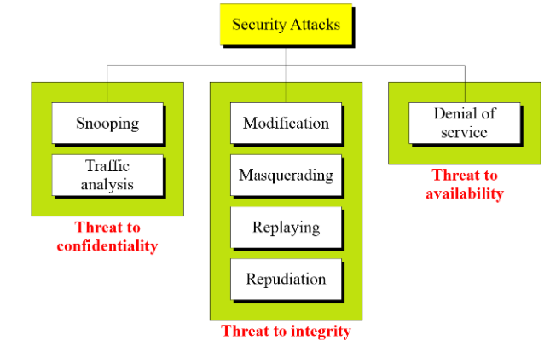
ATTACKS
The three goals of security confidentiality, integrity, and availability can be threatened by security attacks.
Attacks Threatening Confidentiality
Attacks Threatening Integrity
Attacks Threatening Availability

Slide 44
Attacks Threatening Confidentiality
Snooping refers to unauthorized access to another person's or company's data
Traffic analysis refers to obtaining some other type of information by monitoring online traffic.
Attacks Threatening Integrity
Modification means that the attacker intercepts the message and changes it.
Masquerading or spoofing happens when the attacker impersonates somebody else.
Replaying means the attacker obtains a copy of a message sent by a user and later tries to replay it.
Repudiation means that sender of the message might later deny that she has sent the message; the receiver of the message might later deny that he has received the message.
Attacks Threatening Availability
Denial of service (DoS) is a very common attack. It may slow down or totally interrupt the service of a system.

Slide 45
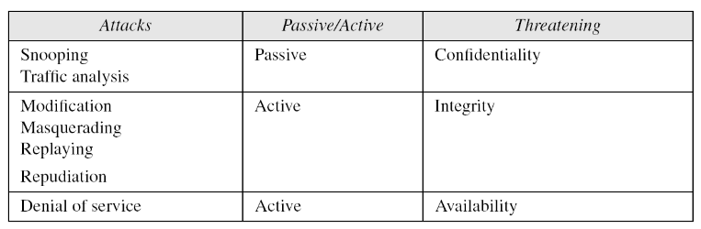

Slide 46
EXPLOITS
An exploit is a code that takes advantage of a software vulnerability or security flaw.
exploits allow an intruder to remotely access a network and gain elevated privileges, or move deeper into the network.
In some cases, an exploit can be used as part of a multi-component attack. Instead of using a malicious file, the exploit may instead drop another malware, which can include backdoor Trojans and spyware that can steal user information from the infected systems.
Zero-Day Exploits and Exploit Kits
an exploit is referred to as a zero-day exploit when it is used to attack a vulnerability that has been identified but not yet patched, also known as a zero-day vulnerability.
Exploits are often incorporated into malware, allowing them to propagate and run intricate routines on vulnerable computers
Exploit kits are popular in the cybercriminal underground because they provide management consoles, an array of exploits that target different applications, and several add-on functions that make it easier to launch an attack.
Mitigating Exploits
Virtual patching is one of the most recommended mitigation solutions for enterprises. Virtual patching works on the premise that exploits take a definable path to and from an application in order to use a software flaw.

Slide 47
INFORMATION GATHERING
Gathering information is the first step where a hacker tries to get information about the target.
Information Gathering is the act of gathering different kinds of information against the targeted victim or system.
It is the first step or the beginning stage of Ethical Hacking, where the penetration testers or hackers (both black hat or white hat) performed this stage; this is a necessary and crucial step to be performed.
The more the information gathered about the target, the more the probability to obtain relevant results.
Information gathering is not just a phase of security testing; it is an art that every penetration-tester (pen-tester) and hacker should master for a better experience in penetration testing.
There are various tools, techniques, and websites, including public sources such as Whois, nslookup that can help hackers gather information.
This step is necessary because you may need any information (such as his pet name, best friend's name, age, or phone number to perform password guessing attack or other kinds of attacks) while performing attacks on any target.
Information gathering can be classified into three categories
Footprinting: Footprinting is the technique to collect as much information as possible about the targeted network/victim/system. It helps hackers in various ways to intrude on an organization's system. Footprinting can be active as well as passive.
Scanning:
Enumeration

Slide 48
INCIDENT RESPONSE TEAM
An incident response team is a group of IT professionals in charge of preparing for and reacting to any type of organizational emergency.
Responsibilities of an incident response team include developing a proactive incident response plan, testing for and resolving system vulnerabilities, maintaining strong security best practices and providing support for all incident handling measures.
Incident response team members typically cover various technical skills, backgrounds and roles to be prepared for a wide range of unforeseen security incidents.
In incident response, types of emergencies are usually categorized in two ways:
Public incidents. These incidents affect an entire community. This could include natural disasters, terrorist attacks and widespread epidemics.
Corporate/organizational incidents. These incidents are typically organization-specific and happen on a smaller scale. This could include data breaches, cybersecurity attacks and physical location threats.
Incident response teams are trained to be prepared for both types

Slide 49
Examples of incident response teams
Computer Security Incident Response Team (CSIRT). This is a team of professionals responsible for preventing and responding to security incidents.
Computer Emergency Response Team (CERT). This is a team of professionals in charge of handling cyberthreats and vulnerabilities within an organization.
Security Operations Center (SOC). This is a type of command center facility that is dedicated to monitoring, analyzing and protecting an organization from cyber attacks.
Incident response team functions and responsibilities::
Generally speaking, the core functions of an incident response team include leadership, investigation, communications, documentation and legal representation.
Leadership. Coordinates the overall direction and strategy of response activities and ensures the team stays focused on minimizing damage, recovering quickly and operating efficiently.
Investigation. Coordinates efforts to determine an incident's root cause. It's important to gather as much relevant information as possible. Specifically, information that can provide value to correct the acute issue as well as prevent future issues.
Communications. Manages relevant internal and external communications necessary for the incident response. Communications may be required across an organization's teams and departments, or with external stakeholders.
Documentation. Keeps records of incident response measures and activities.
Legal representation. Ensures that the incident response activities taken line up with laws and regulations to protect the organization.

Slide 50
REPORTING CRIME
Examine the reporting of crime
1. Why do we need people to report crime?
2. Why don’t people report crime?
3. How can we encourage people to report crime?
Why do we need people to report crime?
Laws reflect the values of society – there is an expectation that members of society will hold others to account for breaching those laws
Police don’t observe most crimes being committed; they are reliant on people to report crimes Police are responsible for enforcing laws – members of society must bring crimes to their attention
How can we encourage people to report crime?
1. Make it easier to report crimes Currently 000, Crime Stoppers, local police station (phone or physical presence) Maybe an app? Text services ;) 2. Educate people (TV, schools, social media, posters…) What constitutes a crime? All crimes matter How to report crime Crime/safety is everyone’s responsibility.

Slide 51
OPERATING SYSTEM ATTACKS
Operating Systems attacks, “attackers look for vulnerabilities in OS such that they can exploit through vulnerabilities and gain access to the target system or network”.
The vulnerabilities in the OS can be open ports and services as most of the operating systems install these services and ports by default. These are the most common vulnerabilities found by attackers to gain access to an operating system.
Some of the OS vulnerabilities list
Buffer Overflow Vulnerability
Bugs in the operating system
Unpatched Operating System
Some of the attacks performed by OS Level
Exploiting specific network protocol implementation
Attacking built-in Authentication System
Breaking file-system Security
Cracking Passwords and Encryption Mechanism

Slide 52
Misconfiguration Attacks: Misconfiguration Attacks can be defined as “occurrence of errors while implementing all security controls”
It may occur either at any stage like developing, deploying, or maintaining, etc. Due to this attackers gain unauthorized access to the systems and affect web servers, databases, etc.
Prevention: Administrators need to change default configuration of the devices and deploy automated scanners.
Application-level Attacks: Defined as “A program or software which can perform a specific function to an end-user or for some other application”.
Since, the code for an application comes with more features and functionalities, there may be some undiscovered security holes or vulnerabilities leaving behind.
This is the opportunity for an attacker to find these vulnerabilities and exploit using different techniques to gain access and steal data.
Prevention: these kind of attacks error checking or handling of applications must be strict.
Shrink-Wrap code Attacks:: It is defined as “exploiting the default configuration and settings of libraries and code”.
Prevention: have to fine-tune every part of the code and make it more secure.

Slide 53
APPLICATION ATTACKS
Examples of Application level Attacks
Buffer Overflow : A buffer overflow attack typically involves violating programming languages and overwriting the bounds of the buffers they exist on.
Session hijacking :: an attacker hijacks a session between a trusted client and network server.
Phinsing :Phishing is a social engineering attack entailing fraudulent communications appearing to come from a trusted source. Phishing attack is that the practice of sending emails that appear to be from trusted sources with the goal of gaining personal information or influencing users to do something.
Denial-of-service : It prevents normal use of communication facilities. This attack may have a specific target.
Man-in-the-middle::A MITM (man-in-the-middle) attack is one where the attacker intercepts and relays messages between two parties who believe they are interacting with one another.
SQL injection:: SQL injection has become a common issue with database-driven websites. a/c username and password ‘1’ = ‘1’

Slide 54
REVERSE ENGINEERING
Reverse-engineering is the act of dismantling an object to see how it works.
It is done primarily to analyze and gain knowledge about the way something works but often is used to duplicate or enhance the object.
Many things can be reverse-engineered, including software, physical machines, military technology and even biological functions related to how genes work.
The practice of reverse-engineering as applied to computer hardware and software is taken from older industries.
Software reverse-engineering focuses on a program's machine code -- the string of 0s and 1s that are sent to the logic processor.
Program language statements are used to turn the machine code back into the original source code.
Purpose of reverse-engineering
The purpose of reverse-engineering is to find out how an object or system works. There are a variety of reasons to do this. Reverse-engineering can be used to learn how something works and to recreate the object or to create a similar object with added enhancements.
Goal:: reverse-engineering software or hardware is to find a way to create a similar product more inexpensively or because the original product is no longer available.
Reverse-engineering in information technology is also used to address compatibility issues and make the hardware or software work with other hardware, software or operating systems that it wasn't originally compatible with.

Slide 55
How does the reverse-engineering process work?
The reverse-engineering process is specific to the object on which its being performed. However, no matter the context, there are three general steps common to all reverse-engineering efforts. They include:Information extraction. The object being reverse-engineered is studied, information about its design is extracted and that information is examined to determine how the pieces fit together. In software reverse-engineering, this might require gathering source code and related design documents for study. It may also involve the use of tools, such as a disassembler to break apart the program into its constituent parts.
Modeling. The collected information is abstracted into a conceptual model, with each piece of the model explaining its function in the overall structure. The purpose of this step is to take information specific to the original and abstract it into a general model that can be used to guide the design of new objects or systems. In software reverse-engineering this might take the form of a data flow diagram or a structure chart.
Review. This involves reviewing the model and testing it in various scenarios to ensure it is a realistic abstraction of the original object or system. In software engineering this might take the form of software testing. Once it is tested, the model can be implemented to reengineer the original object.

Slide 56
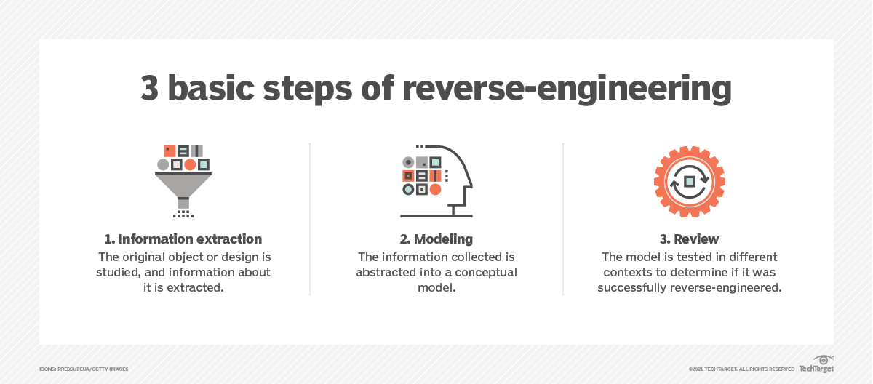

Slide 57
CRACKING TECHNIQUES
Password cracking is the process of using an application program to identify an unknown or forgotten password to a computer or network resource. It can also be used to help a threat actor obtain unauthorized access to resources.
Password cracking is a process of recovering passwords from data that have been stored in or transmitted by a computer system. Examples of guessable passwords include:
Blank (none);
the words like “password,” “passcode” and “admin”;
series of letters from the “QWERTY” keyboard, for example, qwerty, asdf or qwertyuiop;
user’s name or login name;
name of user’s friend/relative/pet;
user’s birthplace or date of birth, or a relative’s or a friend’s;
user’s vehicle number, office number, residence number or mobile number;
name of a celebrity who is considered to be an idol (e.g., actors, actress, spiritual gurus) by the user;
simple modification of one of the preceding, such as suffixing a digit, particularly 1, or reversing the order of letters.
Password cracking attacks can be classified under three categories as follows:
1. Online attacks;
2. offline attacks;
3. non-electronic attacks (e.g., social engineering, shoulder surfing and dumpster diving).

Slide 58
Online Attacks
The most popular online attack is man-in-the middle (MITM) attack, also termed as “bucket-brigade attack” or sometimes “Janus attack.”
It is a form of active eavesdropping in which the attacker establishes a connection between a victim and the server to which a victim is connected.
Offline Attacks
Offline attacks usually require physical access to the computer and copying the password file from the system onto removable media.
Strong, Weak and Random Passwords
A weak password is one, which could be easily guessed, short, common and a system default password that could be easily found by executing a brute force attack and by using a subset of all possible passwords.
A strong password is long enough, random or otherwise difficult to guess – producible only by
the user who chooses it.
Random Passwords
Password is stronger if it includes a mix of upper and lower case letters, numbers and other symbols, when allowed, for the same number of characters.

Slide 59
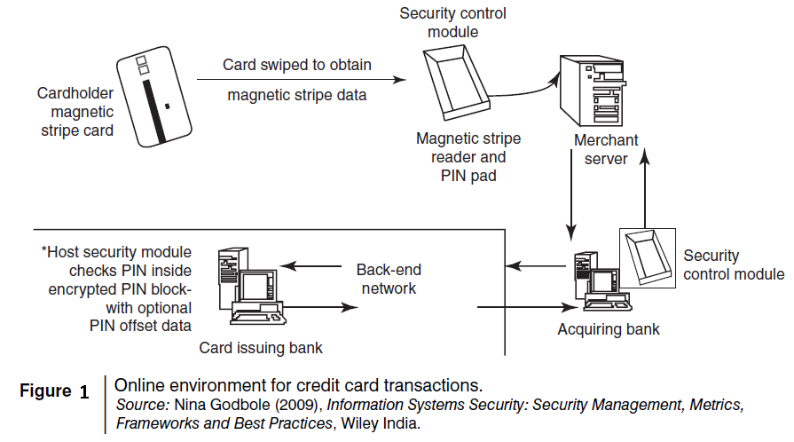
FINANCIAL FRAUDS
Credit card processing is a relatively new service that will allow a person to process credit cards electronically, virtually anywhere.
it allows businesses to process transactions from mobile locations quickly, efficiently and professionally.
It is most often used by businesses that operate mainly in a mobile environment.
Some upscale restaurants are using wireless processing equipment for the security of their credit card paying customers.
Figure 1 shows the basic flow of transactions involved in purchases done using credit cards.

Slide 60
Do’s
1. Put your Signature on the card immediately upon its receipt.
2. Make the photocopy of both sides of your card and preserve it at a safe place to remember the card number, expiration date in case of loss of card.
3. Change the default personal identification number ( PIN ) received from the bank before doing any transaction.
4. Always carry details about contact numbers of your bank in case of loss of your card.
5. Carry your cards in a separate pouch/card holder than your wallet.
6. Keep an eye on your card during your transaction, and ensure to get it back immediately.
7. Preserve all the receipts to compare with credit card invoice.
8. Reconcile your monthly invoice /Statement with your receipts.
9. Report immediately any discrepancy observed in the monthly invoice/statement.
10. Destroy all the receipts after reconciling it with the monthly invoice/statement.
11. Inform your bank in advance, about any change in your contact details such as home address, cell phone number and E-mail address.
12. Ensure the legitimacy of the website before providing any of your card details.
13. Report the loss of the card immediately in your bank and at the police station if necessary.

Slide 61
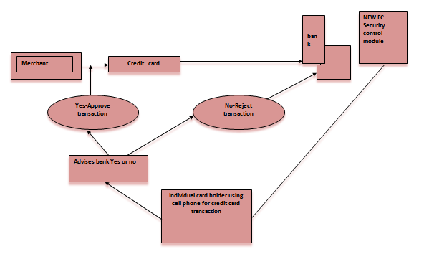
Dont’s :
1. Store your card number and your PINs in your cell.
2. Leave your cards to anyone.
3. Leave cards or transaction receipts lying around.
4. Sign a blank receipt (if the transaction details are not legible, ask for another receipt to ensure the amount instead of trusting the seller).
5. Write your card number/PIN on a postcard or the outside of an envelope.
6. Give out immediately your account number over the phone (unless you are calling to a company/to your bank).
7. Destroy credit card receipts by simply dropping into garbage box/dustbin.
An Australian company “Alacrity” called closed-loop environment for wireless (CLEW).
Flow of events with CLEW is as follows:
Merchant sends a transaction to bank.
The bank transmits the request to the authorized cardholder
[not short message service(SMS)];
The card holder approves or rejects (password protected);
The bank/merchant is notified;
The credit card transaction is completed.

Slide 62
Types and Techniques of Credit Card Frauds:
1.Traditional Techniques
Applications:
1.ID Theft :
Where an individual pretends to be someone else.
2. Financial Fraud:
Where an individual gives false information about his
or her financial status to acquire credit
2.Modern Techniques:
Skimming to commit fraud - the information held on either the magnetic strip on the back of the credit card or the data stored on the smart chip are copied from one card to another.
Site cloning and false merchant sites on the Internet - designed to get people to hand over their credit card details.
1. Triangulation
2.Credit card Generators

